Slide 1
File Management

Slide 2
Contents
File Overview: File Naming, File Structure, File Types, File Access, File Attributes, File Operations, Single Level, two Level and Hierarchical Directory Systems, File System Layout.
Implementing Files: Contiguous allocation, Linked List Allocation, Linked List Allocation using Table in Memory, I-nodes.
Directory Operations, Path Names, Directory Implementation, Shared Files
Free Space Management: Bitmaps, Linked List

Slide 3
Introduction
A file is a collection of correlated information which is recorded on secondary or non-volatile storage like magnetic disks, optical disks, and tapes.
It is a method of data collection that is used as a medium for giving input and receiving output from that program.
Three essential requirements for long-term information storage:
1. It must be possible to store a very large amount of information.
2. The information must survive the termination of the process using it.
3. Multiple processes must be able to access the information at once.
Files are logical units of information created by processes. A disk will usually contain thousands or even millions of them, each one independent of the others.
Information stored in files must be persistent, that is, not be affected by process creation and termination.

Slide 4
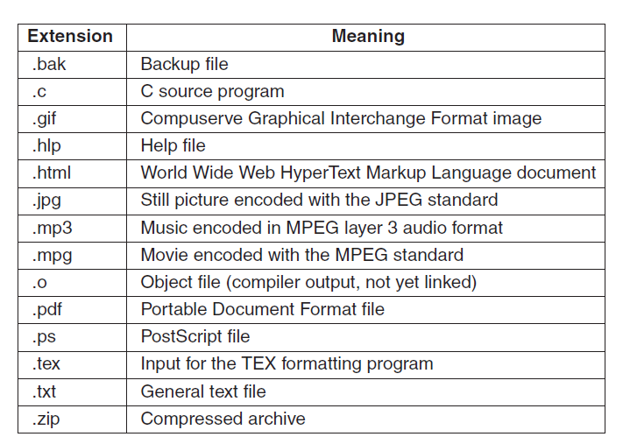
File Naming
Figure 7-1. Some typical file extensions.

Slide 5
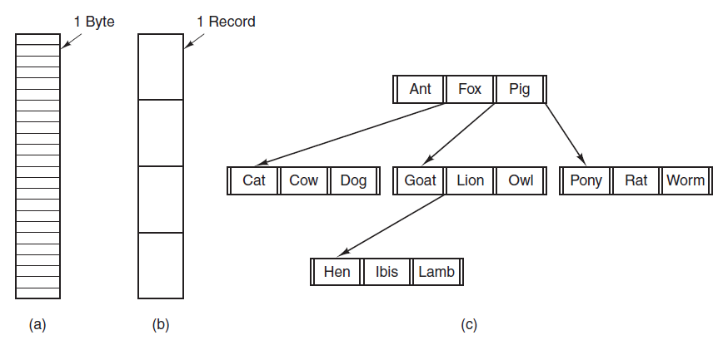
File Structure
Files can be structured in any of several ways. Three common possibilities are depicted in Fig. 7-2.
Figure 7-2. Three kinds of files. (a) Byte sequence. (b) Record sequence.(c) Tree.

Slide 6
The file in Fig. 7-2(a) is an unstructured sequence of bytes. In effect, the operating system does not know or care what is in the file. All it sees are bytes.
Both UNIX and Windows use this approach.
Fig. 7-2(b), a file is a sequence of fixed-length records, each with some internal structure.
No current general-purpose system uses this model as its primary file system any more, but back in the days of 80-column punched cards and 132-character line printer paper this was a common model on mainframe computers.
Fig. 7-2(c), a file consists of a tree of records, not necessarily all the same length, each containing a key field in a fixed position in the record. The tree is sorted on the key field, to allow rapid searching for a particular key.
It is used on some large mainframe computers for commercial data processing.

Slide 7
File Types
Many operating systems support several types of files. UNIX and Windows, for example, have regular files and directories.
Regular files are the ones that contain user information. All the files of Fig. 5-2 are regular files.
Directories are system files for maintaining the structure of the file system.
Character special files are related to input/output and used to model serial I/O devices, such as terminals, printers, and networks.
Block special files are used to model disks.
Regular files are generally either ASCII files or binary files. ASCII files consist of lines of text.

Slide 8
File Access
File access is a process that determines the way that files are accessed and read into memory.
Sequential Access, records are accessed in a certain pre-defined sequence, information stored in the file is also processed one by one.
Random Access is also called direct random access. This method allow accessing the record directly. Each record has its own address on which can be directly accessed for reading and writing.
Random access files are essential for many applications, for example, database systems.
If an airline customer calls up and wants to reserve a seat on a particular flight, the reservation program must be able to access the record for that flight without having to read the records for thousands of other flights first.

Slide 9
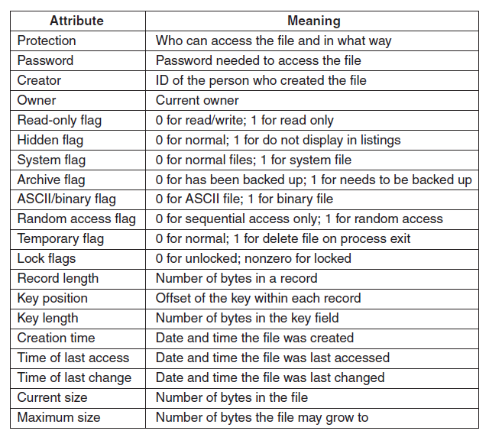
File Attributes
A file has a name and data. Moreover, it also stores meta information like file creation date and time, current size, last modified date, etc. All this information is called the attributes of a file system.
Figure 7-4. Some possible file attributes.

Slide 10
File Operations
The most common system calls relating to files:
1. Create: The file is created with no data.
2. Delete: When the file is no longer needed, it has to be deleted to free up disk space.
3. Open: Before using a file, a process must open it.
4. Close: When all the accesses are finished, the attributes and disk addresses are no longer needed, so the file should be closed to free up internal table space.
5. Read: Data are read from file.
6. Write : Data are written to the file again, usually at the current position.
7. Append :This call is a restricted form of write. It can add data only to the end of the file.
8. Seek. For random-access files, a method is needed to specify from where to take the data.

Slide 11
9. Get attributes: Processes often need to read file attributes to do their work.
10. Set attributes : Some of the attributes are user settable and can be changed after the file has been created. This system call makes that possible.
11. Rename : It frequently happens that a user needs to change the name of an existing file.

Slide 12
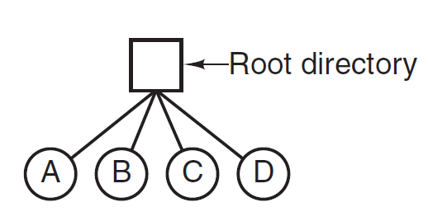
Directories
To keep track of files, file systems normally have directories or folders, which are themselves files.
There are several logical structures of a directory, these are given below.
1. Single-Level Directory Systems
The simplest form of directory system
is having one directory containing all
the files. Sometimes it is called the
root directory
Figure 7-6. A single-level directory system containing four files.

Slide 13
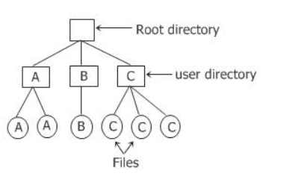
2. Two-level directory systems
In this two-level directory system, names chosen by one user don't interfere with names chosen by a different user and there is no any problem that is caused by the same name occurring in two or more than two directories.
The two-level directory system even on a single-user PC, is inconvenient.
Since it is common for the users, want to group their files together in logical ways.
Figure 7-7. A single-level directory system containing four files.

Slide 14
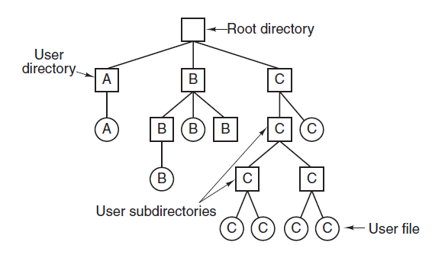
3. Hierarchical Directory Systems
With hierarchical approach, each user on the computer system can have as many directories as are needed, so that files can be grouped together in natural ways.
Here, the directories A, B, and C contained in the root directory each belong to a different user, two of whom have created subdirectories for projects they are working on.
Figure 7-8. A hierarchical directory system.

Slide 15
Path Names
When the file system is organized as a directory tree, some way is needed for specifying file names.
Two different methods are commonly used.
Absolute path name
Relative path name
An absolute path name consisting of the path from the root directory to the file. As an example, the path /usr/ast/mailbox means that the root directory contains a subdirectory usr, which in turn contains a subdirectory ast, which contains the file mailbox.
Absolute path names always start at the root directory and are unique.
Windows: \usr\ast\mailbox
UNIX : /usr/ast/mailbox
MULTICS : >usr>ast>mailbox

Slide 16
The relative path name is used in conjunction with the concept of the working directory (also called the current directory).

Slide 17
Directory Operations
Create: A directory is created. It is empty except for dot and dotdot, which are put there automatically by the system.
Delete: A directory is delete. Here, only those directory can be deleted which are empty.
Opendir: Directories can be read. But before reading any directory, it must be opened first.
Therefore to list all the files present in a directory, a listing program opens that required directory to read out the name of all files that this directory contains.
Closedir: Directory should be closed just to free up the internal table space when it has been read.
Readdir: This call returns the next entry in an open directory.

Slide 18
Rename: Directory can also be renamed just like the files.
Link: Linking is a technique that allows a file to appear in more than one directory.
Unlink: A directory entry is removed.

Slide 19
File-system implementation
From now, we have only view the file system from the users point of view.
Now it's time to view the file system from the implementor point of view.
File system implementors are interested in how files and directories are stored, how disk space for file system is managed, and how to make everything work efficiently and reliably.
File-System Layout
File systems are stored on disks. Most disks can be divided up into one or more partitions, with independent file systems on each partition. Sector 0 of the disk is called the MBR (master boot record) and is used to boot the computer.
The partition table gives the starting and ending addresses of each partition of the disk.

Slide 20
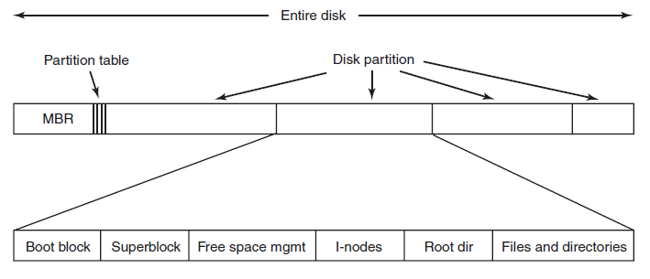
Whenever the computer system is booted up, the bios reads in and executes the master boot record.
The very first thing that the master boot record program does is, locate the active partition, read in its first block, that is called as the boot block and execute it.
The superblock contains all the key parameters about the file system and is read into memory when the computer is booted or the file system is first touched.
Figure 7-10. A possible file-system layout.

Slide 21
Implementing Files
The most important issue in implementing file storage is keeping track of which disk blocks go with which file.
There are various types of file allocations method few of them are:
Contiguous allocation:
A single continuous set of blocks is allocated to a file at the time of file creation. Thus, this is a pre-allocation strategy, using variable size portions. The file allocation table needs just a single entry for each file, showing the starting block and the length of the file.

Slide 22
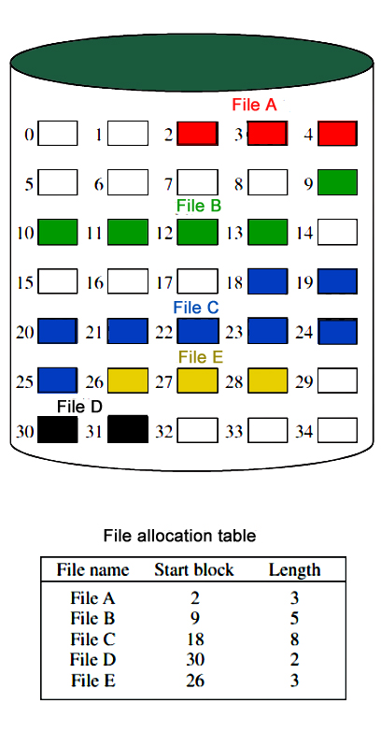

Slide 23
Contiguous allocation requires that each file occupy a set of contiguous blocks on the disk. The word contiguous means continuous.
Advantages:
In the contiguous allocation, sequential and direct access both are supported.
This is very fast and the number of seeks is minimal in the contiguous allocation method.
Disadvantages:
Contiguous allocation method suffers internal as well as external fragmentation.
In terms of memory utilization, this method is inefficient.
It is difficult to increase the file size because it depends on the availability of contiguous memory.

Slide 24
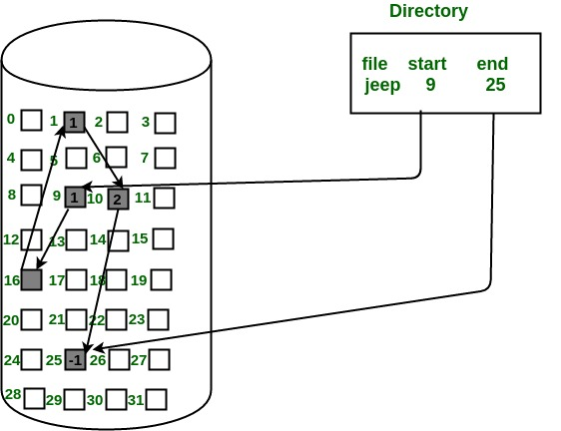
Linked-List Allocation
Linked List allocation solves all problems of contiguous allocation. In linked list allocation, each file is considered as the linked list of disk blocks.
Each disk block allocated to a file contains a pointer which points to the next disk block allocated to the same file.

Slide 25
Advantages:
In terms of the file size, this scheme is very flexible.
We can easily increase or decrease the file size
There is no external fragmentation with linked allocation.
Disadvantages:
Random Access is not provided.
Linked allocation is comparatively slower than contiguous allocation.
Pointers require some space in the disk blocks.
The pointer is extra overhead on the system due to the linked list.

Slide 26
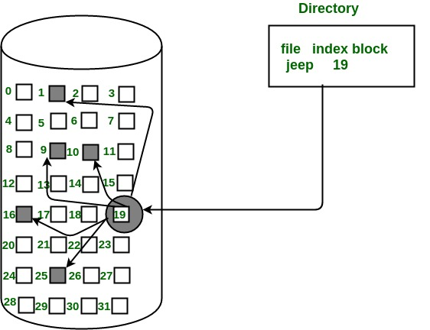
Index allocation
In this scheme, a special block known as the Index block contains the pointers to all the blocks occupied by a file. Each file has its own index block. The ith entry in the index block contains the disk address of the Ith file block.

Slide 27
Index allocation
Advantages:
This supports direct access to the blocks occupied by the file and therefore provides fast access to the file blocks.
It overcomes the problem of external fragmentation.
Disadvantages:
The pointer overhead for indexed allocation is greater than linked allocation.
For very small files, say files that expand only 2-3 blocks, the indexed allocation would keep one entire block (index block) for the pointers which is inefficient in terms of memory utilization. However, in linked allocation we lose the space of only 1 pointer per block.

Slide 28
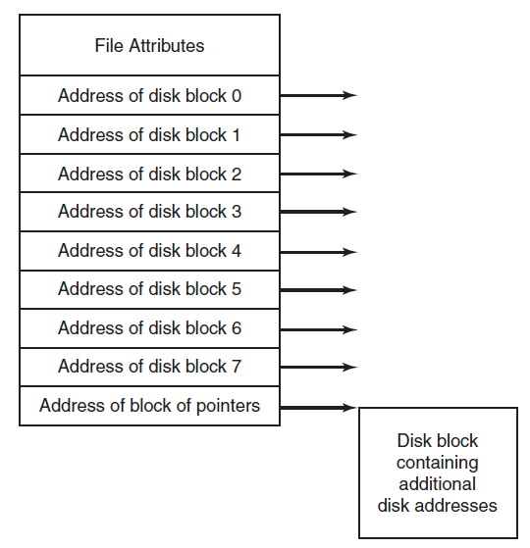
I-nodes (index-node)
To keeping track of which blocks belong to which file is to associate with each file a data structure called an i-node (index-node), which lists the attributes and disk addresses of the file’s blocks.
I-node is a data structure which is used to identify which block belongs to which file.
It contains the attributes and disk addresses of the file's blocks. Unlike the in-memory table the i-node need to be in memory only when the corresponding file is open.
Extra disk blocks may be reserved to store the block addresses of a large file.
Figure 7-14. An example i-node.

Slide 29
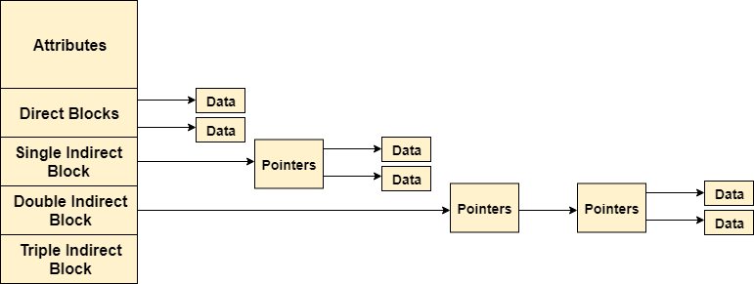

Slide 30
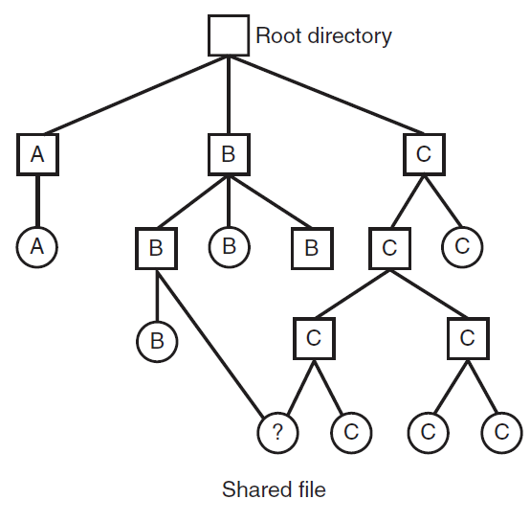
Shared Files
When several users are working together on a project, they often need to share files.
As a result, it is often convenient for a shared file to appear simultaneously in different directories belonging to different users.
Sharing files is convenient but also introduces problems like if the original file or the shared file are appended with new features then it will not be updated in both the copies of the file, it is updated only at its original location.
Figure 7-17. File system containing a shared file.

Slide 31
Disk-Space Management
All the files are normally stored on disk one of the main concerns of file system is management of disk space.
Block Size
The main question that arises while storing files in a fixed-size blocks is the size of the block.
If the block is too large space gets wasted and if the block is too small time gets waste. So, to choose a correct block size some information about the file-size distribution is required.
Keeping track of free blocks
After a block size has been finalized the next issue that needs to be catered is how to keep track of the free blocks. In order to keep track there are two methods that are widely used:
Using a linked list: Using a linked list of disk blocks with each block holding as many free disk block numbers as will fit.

Slide 32
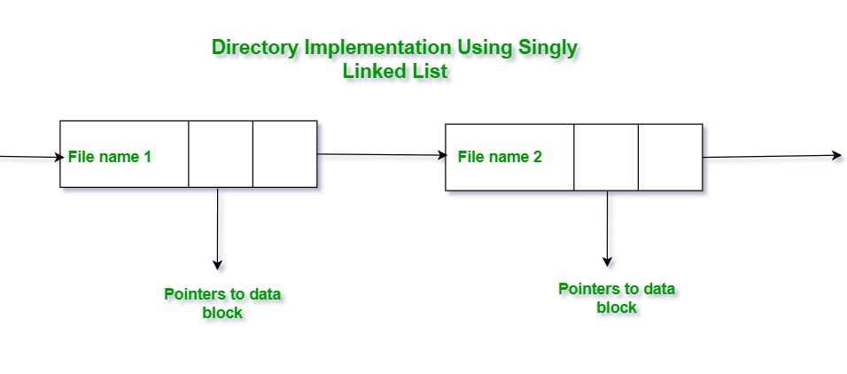
Directory Implementation in Operating System
Directory implementation in the operating system can be done using Singly Linked List and Hash table. The efficiency, reliability, and performance of a file system are greatly affected by the selection of directory-allocation and directory-management algorithms.
Directory Implementation using Singly Linked List
The implementation of directories using a singly linked list is easy to program but is time-consuming to execute. Here we implement a directory by using a linear list of filenames with pointers to the data blocks.
Disadvantage
The main disadvantage of using a linked list is that when the user needs to find a file the user has to do a linear search.

Slide 33
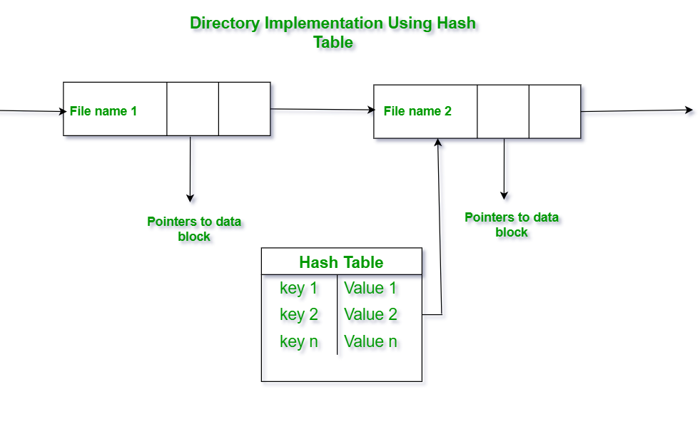
Directory Implementation in Operating System
Directory Implementation using Hash Table:
An alternative data structure that can be used for directory implementation is a hash table. It overcomes the major drawbacks of directory implementation using a linked list. In this method, we use a hash table along with the linked list. Here the linked list stores the directory entries, but a hash data structure is used in combination with the linked list.

Slide 34
Disadvantage:
The major drawback of using the hash table is that generally, it has a fixed size and its dependency on size. But this method is usually faster than linear search through an entire directory using a linked list.

Slide 35
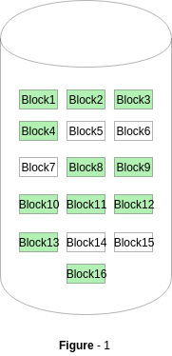
Free space management in Operating System
The system keeps tracks of the free disk blocks for allocating space to files when they are created. Also, to reuse the space released from deleting the files, free space management becomes crucial.
Bitmap or Bit vector:
A Bitmap or Bit Vector is series or collection of bits where each bit corresponds to a disk block. The bit can take two values: 0 and 1: 0 indicates that the block is allocated and 1 indicates a free block.
The given instance of disk blocks on the disk in Figure 1 (where green blocks are allocated) can be represented by a bitmap of 16 bits as: 0000111000000110.

Slide 36
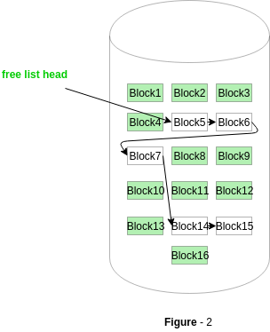
Linked List
In this approach, the free disk blocks are linked together i.e. a free block contains a pointer to the next free block. The block number of the very first disk block is stored at a separate location on disk and is also cached in memory.

Slide 37
Principles of Protection
In computer systems, alot of user’s information is stored, the objective of the operating system is to keep safe the data of the user from the improper access to the system. Protection can be provided in number of ways. For a single laptop system, we might provide protection by locking the computer in a desk drawer or file cabinet.
Types of Access :The files which have direct access of the any user have the need of protection. The files which are not accessible to other users doesn’t require any kind of protection. The mechanism of the protection provide the facility of the controlled access.
Read – Reading from a file.
Write – Writing or rewriting the file.
Execute – Loading the file and after loading the execution process starts.
Append – Writing the new information to the already existing file, editing must be end at the end of the existing file.
Delete – Deleting the file which is of no use and using its space for the another data.
List – List the name and attributes of the file.

Slide 38
Access Control
There are different methods used by different users to access any file. The general way of protection is to associate identity-dependent access with all the files and directories an list called access-control list (ACL) which specify the names of the users and the types of access associate with each of the user.

Slide 39
Access Matrix
View protection as a matrix (access matrix)
Rows represent domains
Columns represent objects
Access(i, j) is the set of operations that a process executing in Domain_{i} can invoke on Object_{j}

Slide 40
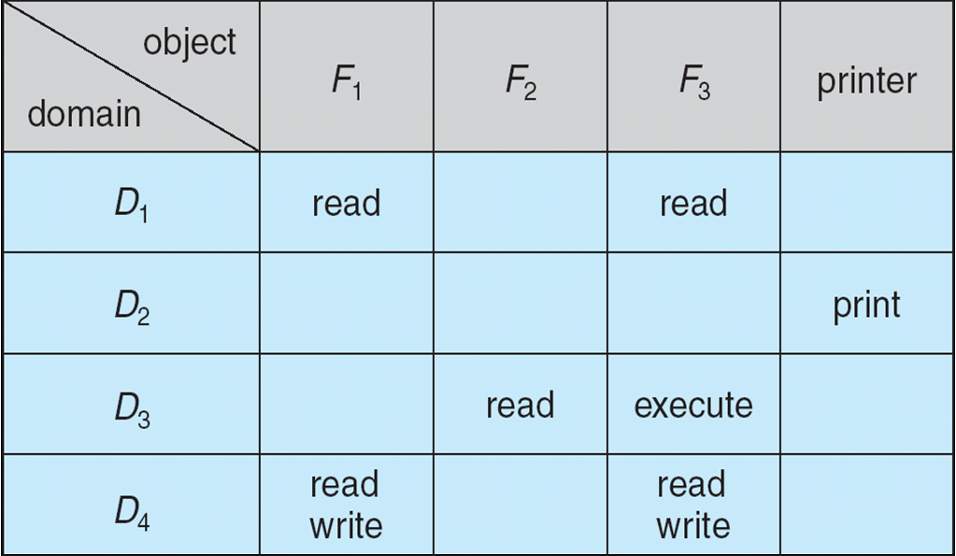
Access Matrix

Slide 41
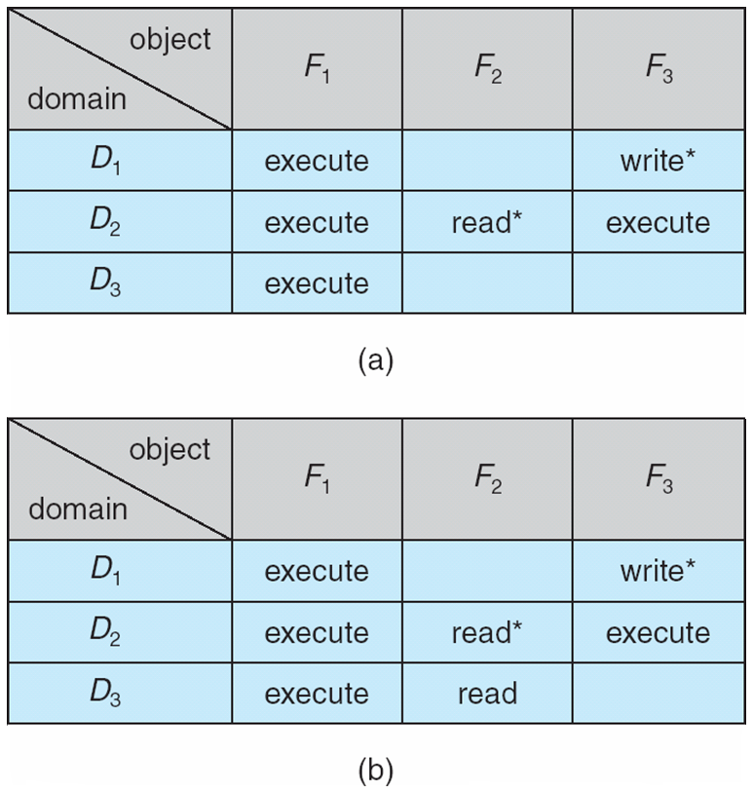
Access Matrix Example

